Slide 1
APPLIED PHYSICS
(SEAP-113)

Slide 2
Full Wave Rectifier
Full wave rectifier allows unidirectional current for entire 360° of input cycle
It is combination of two half wave rectifiers
For this purpose two diodes are used with a centre taped transformer which provides two separate voltages (out of phase) across its secondary winding
One diode conducts and other diode is reverse biased during positive input cycle and vice versa
As a result current is continuously flow through the load resistor

Slide 3
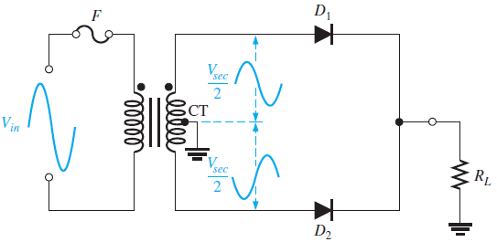
Full Wave Rectifier (contd.)

Slide 4
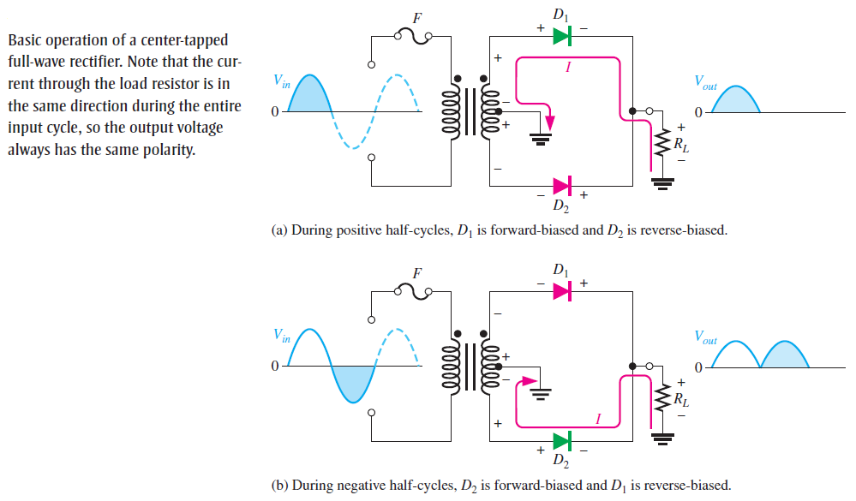
Full Wave Rectifier (contd.)

Slide 5

Full Wave Rectifier (contd.)
The average value of full wave rectifier can be calculated as:
$$V_{Avg}=\frac{{2V}_{P}}{π}$$
Equation shows that V_{avg} is approx. 63.6% of V_{p} (Ideal Diode Case)
The frequency of full wave rectifier will be equal to
$$f_{out}=2f_{in}$$

Slide 6
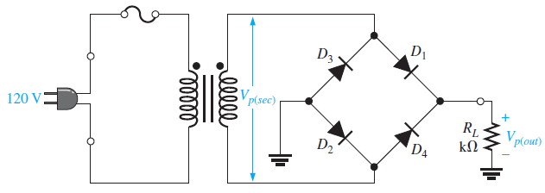
Full Wave Rectifier (contd.)
Another type of full wave rectifier is Bridge Rectifier

Slide 7
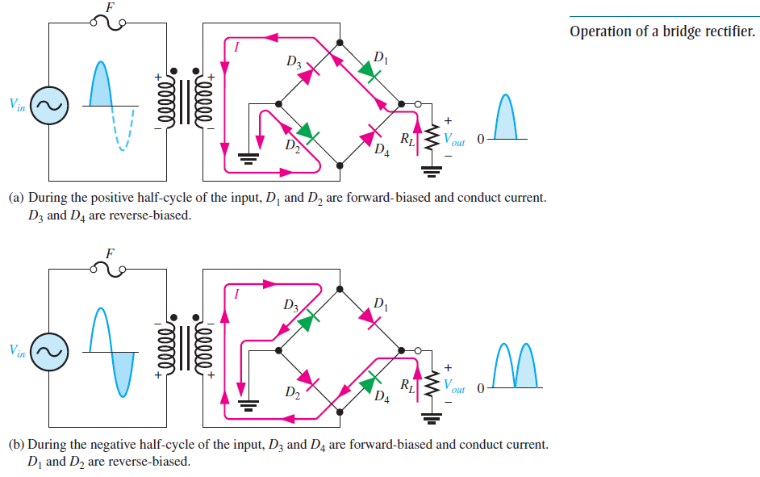
Full Wave Rectifier (contd.)

Slide 8

Full Wave Rectifier (contd.)
the bridge output voltage in case of ideal approx. can be calculated as:
$$V_{P(out)}= V_{P(sec)}$$
By using the second approx. the bridge output voltage can be calculated as:
$$V_{P(out)}=V_{P(sec)}−1.4V$$

Slide 9
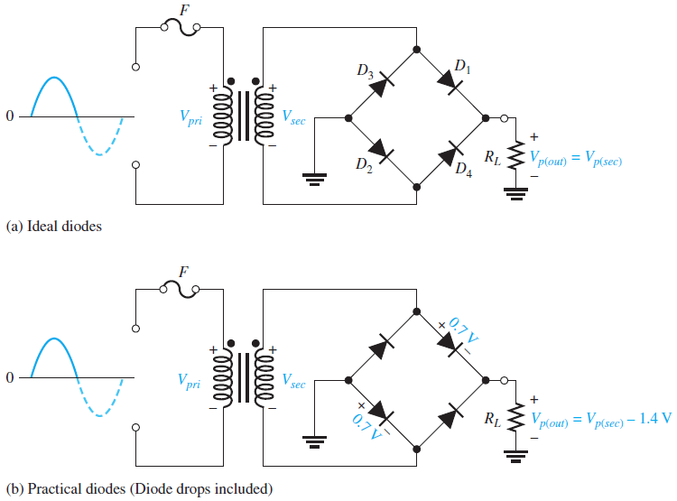
Full Wave Rectifier (contd.)

Slide 10
Power Supply Filtering
For a power supply there must be a constant voltage amplitude without fluctuations
The output of a Full wave or Half Wave rectifier is not constant
There must be some filtering to smoothen the output of rectifiers

Slide 11
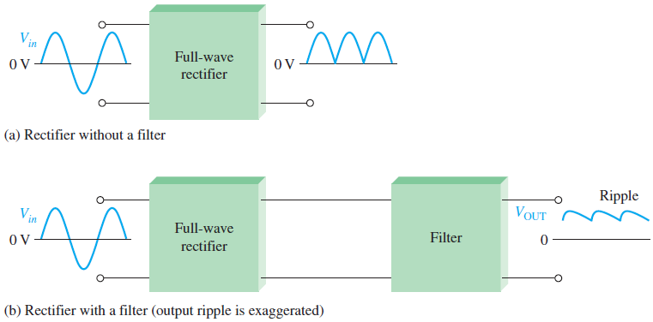
Power Supply Filtering (Contd.)

Slide 12
Power Supply Filtering (contd.)
Capacitor input filter is used for filtering
Capacitor is attached at the output of rectifier
when the positive cycle arrived, diode becomes forward bias
The capacitor start charging and it continues as voltage is increasing, when voltage starts decreasing, capacitor starts discharging and diode becomes reverse bias
The time constant RC determines the discharging rate of capacitor
Larger the time constant, lesser the capacitor discharge

Slide 13
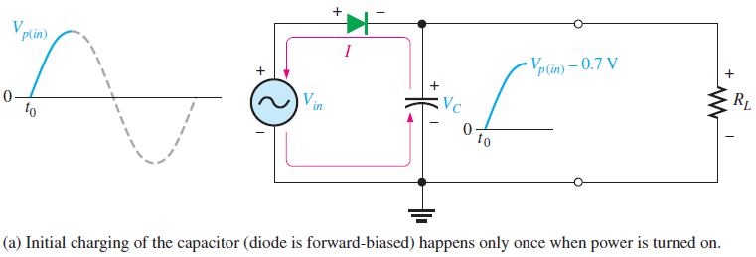
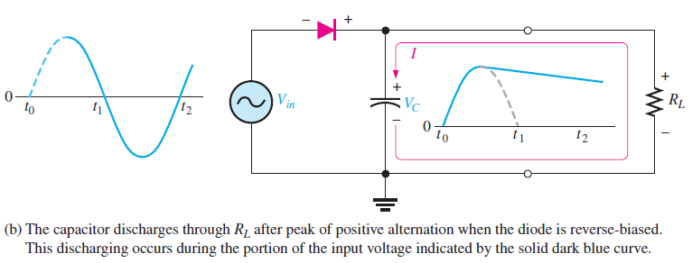
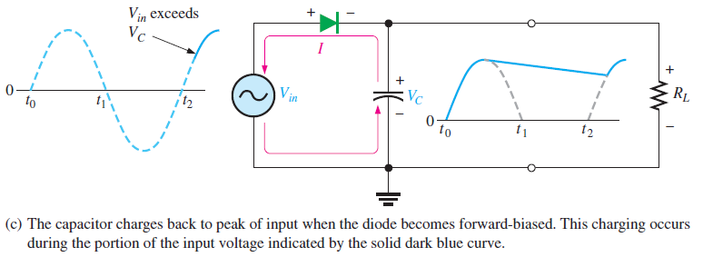
Power Supply Filtering (contd.)

Slide 14
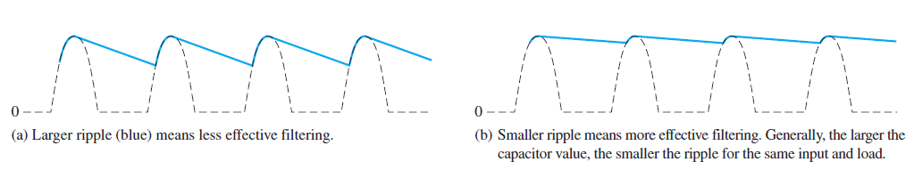
Power Supply Filtering (contd.)
Capacitor quickly charge and slowly discharge during the complete cycle
Variation in the capacitor voltage due to charging and discharging is known as ripple voltage
Smaller the ripple, better the filtering

Slide 15
Power Supply Filtering (contd.)
Full wave rectifier has double the frequency as compare to half wave rectifier
It is easier to filter the full wave rectifier output as there is short time between peaks
When filtered with same load resistor and capacitor, full wave rectifier has small ripple as compared to half wave rectifier
Because capacitor discharges less during the short intervals between full peaks

Slide 16
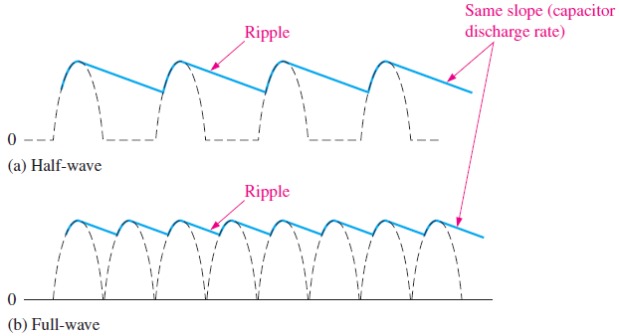
Power Supply Filtering (contd.)

Slide 17
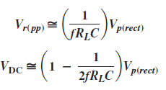
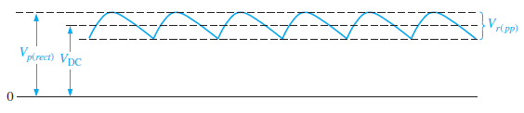

Power Supply Filtering (contd.)
The ripple factor (r) (amount of AC content present in DC output) is effectiveness of filter and defined as
$r=\frac{Vr(pp)}{VDC}$

Slide 18
